Slide 1
Pampered Pet$
An analysis of U.S. spending trends

Slide 2
Spending on U.S. Pets by Type

Slide 3
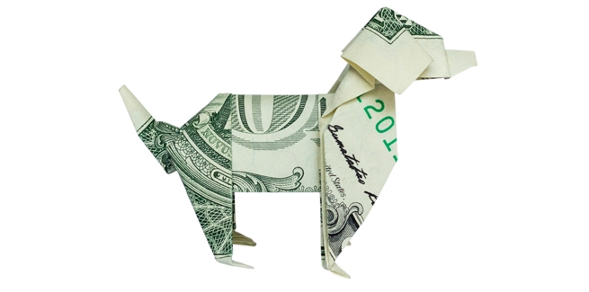
Millennials drive increases
From 1996 to 2018 yearly spending on pets went from $21 to $72 billion dollars.

Slide 4
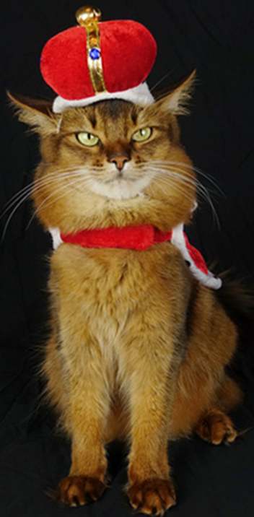
Eating and snacking like kings
In 2018, Americans spent most of their pet care dollars on food—$29 billion.

Slide 5

The doctor will see you now
Healthcare for pets is the fastest-growing sector of pet spending at 6.1% per year.

Slide 6

Pets go high tech
Pet owners are more likely to use digital devices—and buy them for their pets.

